Slide 1
GENERAL INDUCTION

Slide 2
Induction
This induction is designed to give you an overview of our policies, procedures and rules within the organisation.
More detailed information can be found in the business management system.
At any time you’re not sure about something please ask.

Slide 3
Who we are and what we do
Comiskey Mining Services (CMS) is an innovative Earthmoving Equipment Rental business supplying the resources sector. CMS specialise in dry equipment hire and also tailor maintenance packages to suit customer requirements.

Slide 4
ISO Certification
Comiskey Mining Services have the following certifications

Slide 5
Company Polices
Our Management System is based on:
ISO 9001:2015
ISO 45001:2018
ISO 14001: 2015

Slide 6
Obligations
Under legislation (Coal Mining ACT & REG and the WHS ACT & REG) all companies & persons have an obligation to either:
provide a safe work environment including the required systems, processes, training, tools and PPE.
Follow safe work practices and
Be a part of safety

Slide 7
Risk Management

Slide 8
Hazard & Risk
A hazard is something with the potential to cause harm.
Risk is the likelihood that a harmful consequence (death, injury or illness) might result when exposed to the hazard.
Our goal is to eliminate the hazard
If we can’t eliminate the hazard we control the hazard using the hierarchy of control

Slide 9
Hierarchy of Control
1. Elimination The most desirable option- If you eliminate a hazard you completely eliminate the associated risk.
2. Substitution You can substitute something else (a substance or a process) that has less potential to cause injury.
3. Isolation/engineering You can make a structural change to the work environment or work process to interrupt the path between the worker and the risk.
4. Administrative You may be able to reduce risk by upgrading training, changing rosters or other administrative actions.
5. Personal protective equipment The least desirable option- When you can't reduce the risk of injury in any other way, use personal protective equipment (gloves, goggles, etc.) as a last resort.

Slide 10
Risk Assessments (RA) / JSA’s / SWEMS
A Risk Assessment & Safe Work Environmental Method Statement must be completed prior to any high risk activity. A SWEMS is a document that list the steps needed to undertake the task and the risk involved, it will also include the control methods you will use to lower the risk.

Slide 11
Plant & Equipment
All plant & equipment is to be fully serviced and maintained as per manufacturer requirements. Any damage for faults must be reported and the plant or equipment is to be locked & tagged out and repaired.
Under no circumstances should locked / tagged out plant or equipment be used.
Personnel Tags protect Personnel
Out of Service Tags Protect Equipment

Slide 12
Operation of Equipment
You are not to drive or operate any vehicle, plant or other equipment, unless you have the appropriate certificate / Licence or are under instruction/training and have appropriate authorisation.
Each site will have their own pass out requirements
You must not operate any vehicle, plant or equipment which you are not competent, if you have any doubt check with your supervisor.
If you are caught operating any plant or equipment for which you are not licenced / competent or authorised to operate you may have your employment / contract terminated.

Slide 13
Pre-starts/Daily Checks
Pre-starts / Daily Checks on equipment are mandatory and must be completed before every shift when in use.

Slide 14
Consultation
Under current legislation employers must consult with their employees to enable the employees to contribute to the making of decisions affecting their health, safety and welfare at work.
Consultation is undertaken by toolbox talks / notice boards / electronic media and or one on one meetings

Slide 15
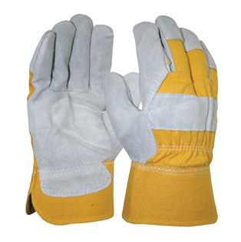
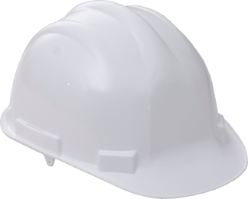
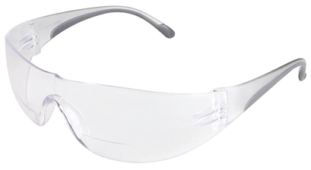
Personal Protective Equipment
The appropriate PPE must be worn for the task at hand, bearing in mind that P.P.E should not be relied on as the main control measure.
P.P.E should be used in accordance with manufacture’s specifications, the user should be trained on its correct use and storage.
Any damaged P.P.E is to be replaced immediately.

Slide 16
Electrical Equipment
All electrical items are to be maintained as per manufacturer requirements and be tested and tagged in accordance with legislation and or site requirements.

Slide 17
Hazardous Substances
Hazardous Substances must be approved for use onsite prior
It is mandatory that if you are using hazardous substances that you review the risk assessments and the Safety Data Sheets for the substance before use.
Items used include: sprays, gases, fuels, paints etc

Slide 18
Manual Handling
Manual Handling is any human movement to push, pull, lift, lower, hold, throw, carry, pack, it also includes repetitive or sustained movement of typing, assembling, cleaning and using tools
Plan the lift or movement
Don’t lift/move more than you can comfortably handle (everyone is going to be different)
Use mechanical aids i.e. pallet jacks or trolleys
Is a team lift possible
Ensure you have a clear well lit path to your destination

Slide 19
Working at Heights
If a person is at risk of falling from one level to another that is reasonably likely to cause injury to the person or any other person you must apply the appropriate control measures. A risk assessment must be completed before any working at heights activity, the hierarchy of control should be used to eliminate or control the risk.

Slide 20
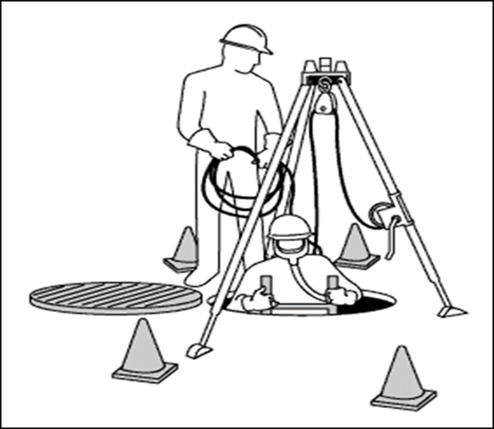
Confine Space
Under no circumstances shall anyone enter a confined space i.e. Tunnels, silo’s, tanks etc without all relevant permits to enter forms, risk assessments and SWMS completed & signed off by all parties involved.

Slide 21
Working Alone
Workers shall not work in an isolated situation without a pre-defined system of contact.
A person shall not work alone in any place designated as hazardous. For other areas, lone employees shall be visited or communicated with at regular intervals.
A risk assessment must be conducted to establish emergency procedures.

Slide 22
Working Environments
The weather can change very rapidly
Plan as best as you can to suit your work environment
Ensure you have enough water, a hat, sun screen etc..
Warm clothing
Rain jacket
Can you change your working times to avoid excessive heat or cold
Environmental conditions should be included in your risk assessments

Slide 23
Site Specific Inductions
All major sites will have a site specific induction to be completed prior to work commencing, you must obey all site rules and safety signs in and around the site.

Slide 24
Uniforms
All uniforms are to be kept clean and tidy
Any damaged, ripped or torn clothing is to
be replaced.
Hi Viz clothing that is faded and worn is to
be replaced.

Slide 25
Injuries & First Aid
All accidents must be reported to your supervisor asap, first aid should be administered where required. First aid kits are located in the office, company vehicles.
In an emergency dial 000.
An incident investigation report will need to be completed and any medical certificates should be given to your supervisor asap

Slide 26
Fit For Duty
You must ensure that you are fit for duty at the beginning of your shift. If you’re sick, under the influence of a legal or illegal substance and or fatigued it may effect your judgment and work performance, poor judgment can lead to a permanent injury, illness or death.

Slide 27
Drugs & Alcohol
CMS has a (0) ZERO tolerance level on consumption of DRUGS and ALCOHOL during working hours, this includes all breaks.
Anyone found to be under the influence of DRUGS or ALCOHOL may have their contract terminated.
Random drug & alcohol testing is conducted, employees refusing to be tested may have their contract terminated.

Slide 28
Rehabilitation
CMS has a Rehabilitation policy and procedure inline with government requirements.
All injuries requiring rehabilitation and or suitable duties must be coordinated through the rehabilitation coordinator and your supervisor.

Slide 29
Reporting Process
All incidences including near misses have to be reported and investigated to ensure corrective & preventative actions are put into place to prevent a reoccurrence.

Slide 30
Notifiable Events
We are required by law to report serious bodily injuries, work caused illness and dangerous events.
Notification is required immediately after becoming aware that a notifiable incident has happened.

Slide 31
Safety Breaches
Any deliberate breaches of safety will be dealt with in accordance with the company’s disciplinary procedure and appropriate Work Health & Safety laws.

Slide 32
Company Vehicles
Company vehicles are to be maintained as per company policy.
Vehicles are to be kept clean and tidy and any damaged to reported to your supervisor ASAP.
Drivers are to obey all road rules and regulations
Drivers are to drive to the conditions of the road
Any fines pertaining to the misuse of company vehicles will be paid by the driver.
CMS are not responsible for private property within the vehilce

Slide 33
Personal Items & Tools
CMS takes no responsibility for employees own personal equipment, tools or items whether in company vehicles, workshop, yard or office. Personal belongings are not covered by our insurance and if they are damaged or stolen CMS will not replace them.

Slide 34
Smoking
Smoking is not permitted in any company vehicle, or building. You must be at least 4m from an entry to a building to smoke.
Please smoke in designated areas only and ensure cigarette buts are place in the appropriate bins.

Slide 35
Harassment
Harassment is the act of systematic and/or continued unwanted and annoying actions of one party or a group, including threats and demands.
CMS is committed to ensuring an environment free from physical harassment, sexual harassment, bullying, abuse, discrimination, vilification, victimization or miss-treatment in any way shape or form in any location.
All incidents of harassment / bullying will be fully investigated and dealt with accordingly. In some circumstances the police may be called in.

Slide 36
Emergency
In the unlikely event of an emergency all persons are to listen and follow directions from emergency wardens
evacuate to the muster point if required
Assist people who may require help
Follow directions from authorities

Slide 37
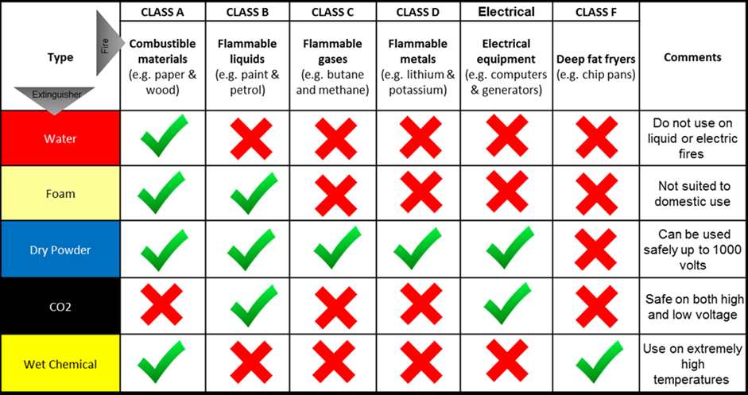
Fire Extinguishers
Fire extinguishers are available in all offices and on all plant & equipment & company vehicles
Fire extinguishers are to be used in an emergency situation only.
If you use an extinguisher notify
your supervisor ASAP.

Slide 38
Job Dockets and Paperwork
All paperwork is to be fully completed after every job including parts and what work was completed.
Technicians are to print their name, sign and date all records
Handed into the office once completed

Slide 39
Tag out & Lock out
CMS has a strict Tag out & Lock out procedure in place.
All equipment being serviced, repaired etc needs to be locked out and tagged out at every ignition source.
If a tag or lock is in place it is NOT to be removed, anyone found to have removed some one else's tag or lock may have their employment or contract terminated.

Slide 40
Housekeeping
All work areas are to be kept clean and tidy
At the end of your shift ensure that all rubbish is disposed of and tools are put away
Ensure chemicals or liquids are stored correctly
Poor housekeeping is a fire and injury hazard
This applies to company vehicles

Slide 41
Do the right thing
All the company ask of you is to “do the right thing”
ensure you have the correct tools for the job which includes PPE
ensure you have a safe work environment
ensure you have the correct procedures in place
Be apart of safety
Look out for your workmates
If something isn’t right fix it or bring it to the attention of your supervisor
And if you’re not sure of anything just ask.

Slide 42
Questionnaire
Please click on the link below to complete the induction questionnaire.
Induction Questionnaire

